Slide 1
Marisska
By: Ayleen Escamilla and Kathrynn Mier
Montwood High School
Medical Innovations

Slide 2


Wait times in an ER
On average in America people spend about 145 minutes waiting in an emergency room
1 in 500 patients die in the ER
200,000 patients die yearly
Why does it take so long?
Doctors and Nurses get busy with
paperwork
Diagnoses
Overcrowding

Slide 3

Past/Present Solutions
Triages: Urgent, Non-Urgent, and Immediate
For clinics: Online appointments and scheduling online
Emergency rooms: Vitals done in the waiting rooms

Slide 4

Our Nurse Robot
Goes up to patients in waiting rooms and allows them to enter their information, medical history, information needed for treatment
Takes patients vitals
Can transport medication from one place to another

Slide 5

Design Criteria
Will be specifically made to the design of the hospital/ clinic so it is able to safely move around
Sensors around the body
Touchscreen face for employee and patient use
Friendly face

Slide 6
Constraints
Not getting the patients in the order they came in
Once the robot is designed the seating of the rooms will not be able to be changed
Amputee patients will not be able to have their vitals checked

Slide 7
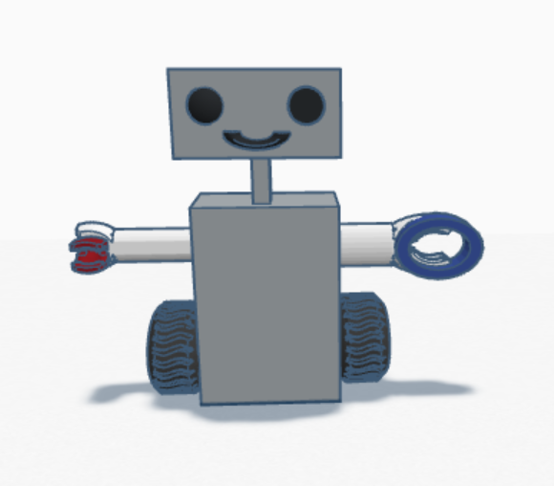
Our prototype
Hi Im Marisska
Moveable arms
Blood Pressure Monitor hands
Heart Rate Hands
Touchscreen Tablet

Slide 8


Costs of Manufacturing
Plastic (body of the robot)
Wholesale 14 Gauge Steel in mm Steel Plate Carbon Steel Plate,Carbon Steel Sheet
-$300
- metal paint
-$50
Wheels
$30
Touchscreen device
7’ touchscreen monitor
-$382
Software to make the robot work
Hiring a software engineer $325 hr
Blood pressure monitor
Pulse MD pro
- $118
Total: 1205 without the cost of a software engineer

Slide 9


Testing Criteria
Find hospital to use the robot
Test Robot in environment
Collect waiting times of each patient
Analyze Data

Slide 10

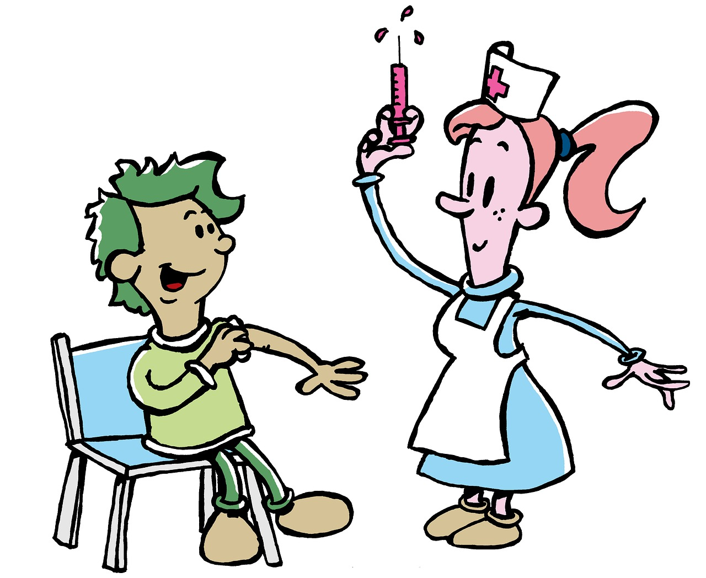
Testing Method: Survey
Was Marisska able to help the nurses improve patient care?
Timing patients and how long their visits are
After being used for a few months data will be
analyzed

Slide 11
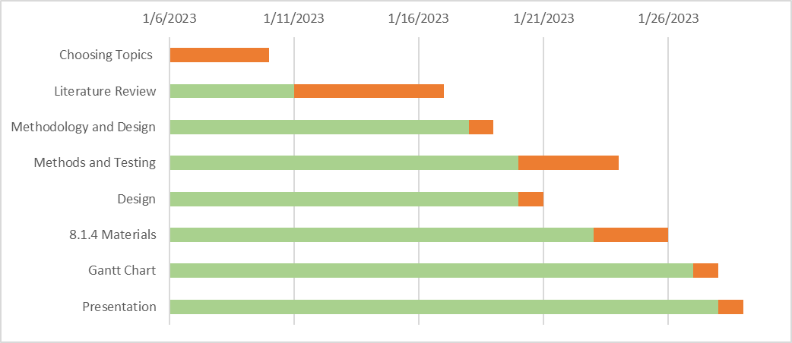
Gantt Chart

Slide 12
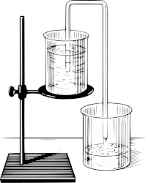

Conclusion
Benefit: Hospitals will be able to see more patients
Help: Patients feel like they will be seen faster
Gain: Less clogged ER
Reduced: Amount of wait time

Slide 13
Sources
Bonett, J. B. (2022, June 29). Meet 'moxi' – robotic hospital helper to give nurses more time to do what they do best. ChristianaCare News. Retrieved January 17, 2023, from https://news.christianacare.org/2022/05/meet-moxi-robotic-hospital-helper-to-give-nurses-more-time-to-do-what-they-do-best/
Collaborative Robot Aims to Ease Stress on Nurses | AHA. (2022, June 14). American Hospital Association. Retrieved January 17, 2023, from https://www.aha.org/aha-center-health-innovation-market-scan/2022-06-14-collaborative-robot-aims-ease-stress-nurses
Howley, E. K. (2018, October 26). Why Do I Have to Wait So Long to Be Seen in the Emergency Room? US News Health. Retrieved January 17, 2023, from https://health.usnews.com/health-care/patient-advice/articles/2018-10-26/why-do-i-have-to-wait-so-long-to-be-seen-in-the-emergency-room
Patients or paperwork? - procentive. (n.d.). Retrieved January 18, 2023, from https://procentive.com/wp-content/uploads/2015/02/FinalPaperworkReport.pdf
Patients over paperwork: Guidance portal. Patients Over Paperwork | Guidance Portal. (n.d.). Retrieved January 18, 2023, from https://www.hhs.gov/guidance/document/patients-over-paperwork-0
Soriano, G. P., Yasuhara, Y., Ito, H., Matsumoto, K., Osaka, K., Kai, Y., Locsin, R., Schoenhofer, S., & Tanioka, T. (2022, August 18). Robots and robotics in nursing. Healthcare (Basel, Switzerland). Retrieved January 17, 2023, from https://www.ncbi.nlm.nih.gov/pmc/articles/PMC9407759/
Vital Signs (Body Temperature, Pulse Rate, Respiration Rate, Blood Pressure). (n.d.). Johns Hopkins Medicine. Retrieved January 17, 2023, from https://www.hopkinsmedicine.org/health/conditions-and-diseases/vital-signs-body-temperature-pulse-rate-respiration-rate-blood-pressure
Why the Role of Nurses Is Important in Healthcare - ABSN. (2021, November 8). Mercer ABSN. Retrieved January 17, 2023, from https://absn.mercer.edu/blog/why-the-role-of-nurses-is-important-in-healthcare/
Strelnikova, I. (2022). People characters sitting on chairs and waiting appointment time in... iStock. Retrieved March 31, 2023, from https://www.istockphoto.com/vector/hospital-gm1177027277-328416297

Slide 14
Summary
Introudction:
One of the many reason people dread hospitals and emergency rooms is because of their wait times. We have decided to make a “nurse” robot who will help lower the time patients wait to be treated.
Procedures:
Introduce idea of robot
Find buyers
Trial run robot
Acquire feedback
Conclusion:
We are hoping to minimize not only wit times but help out staff in the hospital spend more one on one time with their patients
Question: Will and how will our Nurse robot be helpful in waiting rooms?

